Slide 1
Tables Benchmark

Slide 2
Index
Table Detection (TD)
TD in ICDAR 19 TRACK A
SparkOCR TD results
DETR TD results
Conclusions
TD in PubTables-1M
Conclusions
Table Structure Recognition (TSR)
TSR in ICDAR 19 TRACK B
TSR in PubTables-1M
DETR TSR visual example

Slide 3
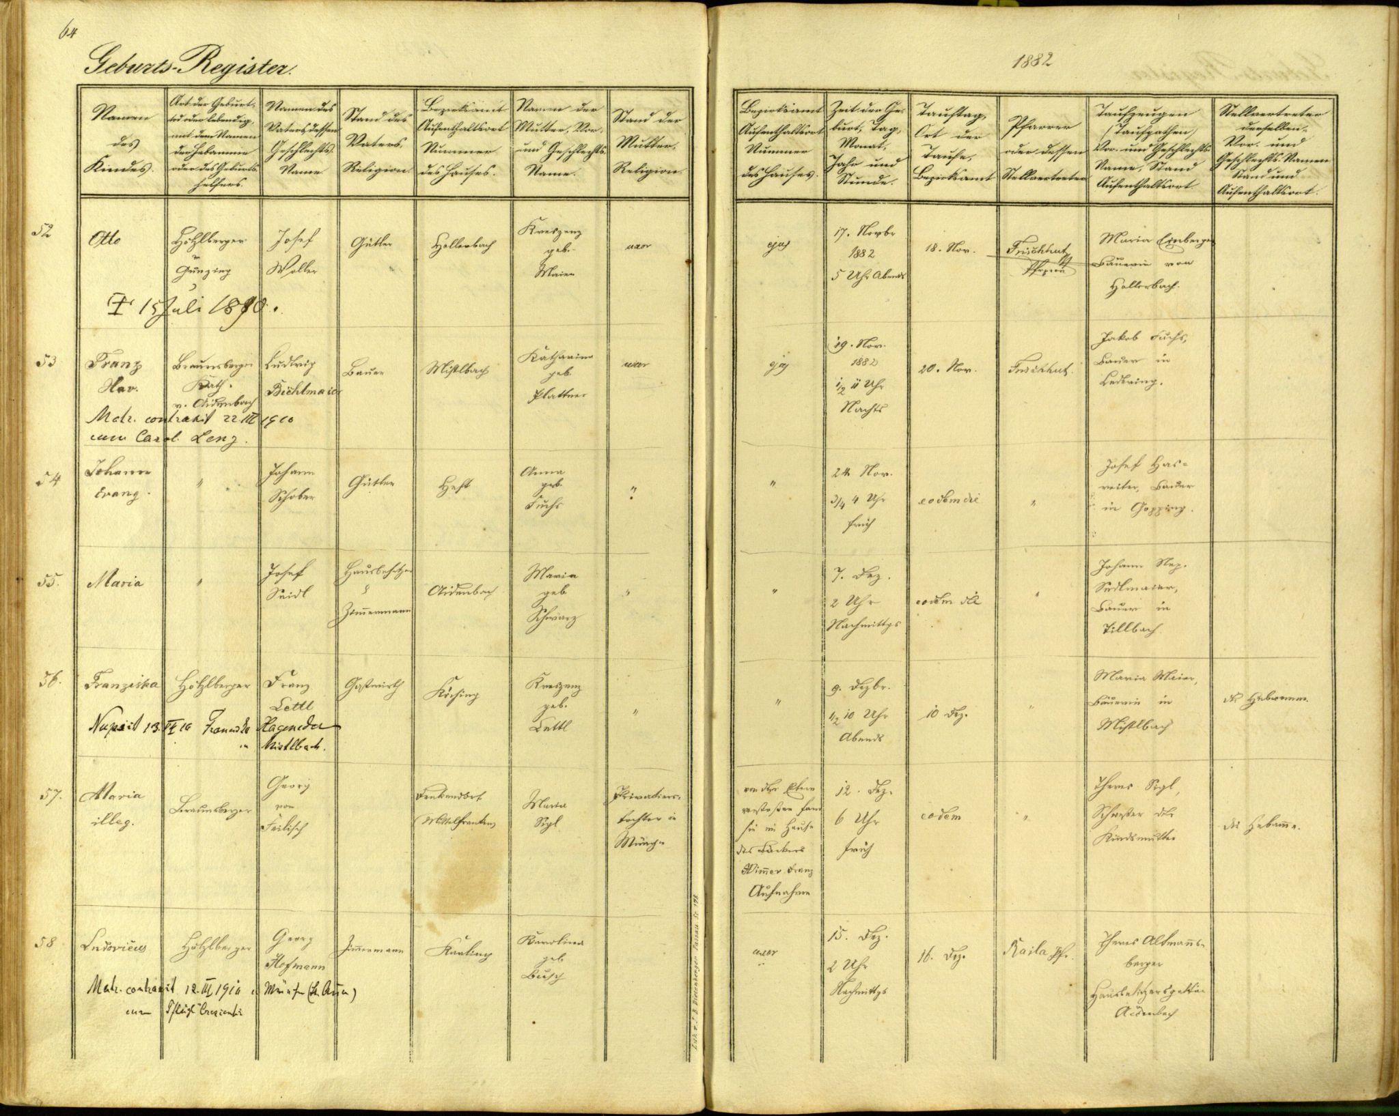
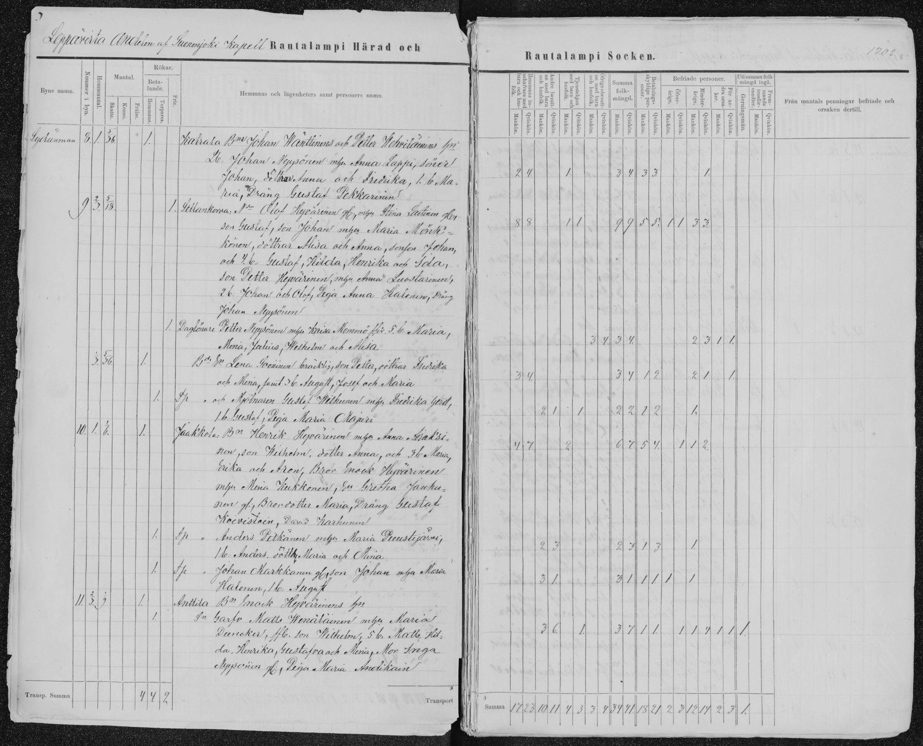

Table Detection (TD)
1.1. Dataset: ICDAR 19 TRACK A
cTDaR_t10070.jpg
cTDaR_t10809.jpg
cTDaR_t10085.jpg

Slide 4
1.1.1. SparkOCR TD results
general_model_table_detection_v2
icdar_19_track_a_modern_td & icdar_19_track_a_modern_td_v2
icdar_13_td & table_bank_both_td
Evaluation of trackA
IOU @ 0.6 -
precision: 0.9226666666666666
recall: 0.7706013363028953
f1: 0.8398058252427184
correct: 346, gt: 449, res: 375
IOU @ 0.7 -
precision: 0.9013333333333333
recall: 0.7527839643652561
f1: 0.8203883495145631
correct: 338, gt: 449, res: 375
IOU @ 0.8 -
precision: 0.896
recall: 0.7483296213808464
f1: 0.8155339805825244
correct: 336, gt: 449, res: 375
IOU @ 0.9 -
precision: 0.8453333333333334
recall: 0.7060133630289532
f1: 0.7694174757281554
correct: 317, gt: 449, res: 375
/content
Evaluation of trackA
IOU @ 0.6 -
precision: 0.9333333333333333
recall: 0.9042316258351893
f1: 0.918552036199095
correct: 406, gt: 449, res: 435
IOU @ 0.7 -
precision: 0.9126436781609195
recall: 0.8841870824053452
f1: 0.8981900452488688
correct: 397, gt: 449, res: 435
IOU @ 0.8 -
precision: 0.9080459770114943
recall: 0.8797327394209354
f1: 0.8936651583710407
correct: 395, gt: 449, res: 435
IOU @ 0.9 -
precision: 0.8505747126436781
recall: 0.8240534521158129
f1: 0.8371040723981901
correct: 370, gt: 449, res: 435
/content
Evaluation of trackA
IOU @ 0.6 -
precision: 0.9333333333333333
recall: 0.9042316258351893
f1: 0.918552036199095
correct: 406, gt: 449, res: 435
IOU @ 0.7 -
precision: 0.9149425287356322
recall: 0.8864142538975501
f1: 0.9004524886877827
correct: 398, gt: 449, res: 435
IOU @ 0.8 -
precision: 0.9080459770114943
recall: 0.8797327394209354
f1: 0.8936651583710407
correct: 395, gt: 449, res: 435
IOU @ 0.9 -
precision: 0.8528735632183908
recall: 0.8262806236080178
f1: 0.8393665158371041
correct: 371, gt: 449, res: 435
/content
They have the same result.
The model have to be the same
They have the same result.
The model have to be the same

Slide 5
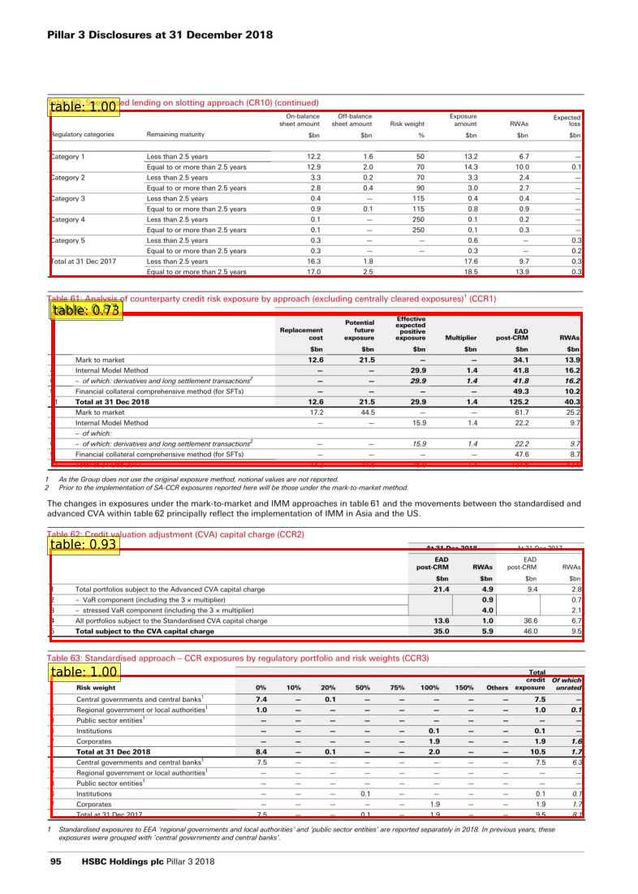
1.1.2. DETR TD results
DETR_td v2 has the same result as DETR_td. The model have to be the same
For more info about this implementation see notebook: “Spark-ocr table detection evaluation on ICDAR 2019 B1.ipynb”
Evaluation of trackA
IOU @ 0.6 -
precision: 0.8079800498753117
recall: 0.45314685314685316
f1: 0.5806451612903226
correct: 324, gt: 715, res: 401
IOU @ 0.7 -
precision: 0.7805486284289277
recall: 0.43776223776223777
f1: 0.5609318996415771
correct: 313, gt: 715, res: 401
IOU @ 0.8 -
precision: 0.7107231920199502
recall: 0.3986013986013986
f1: 0.510752688172043
correct: 285, gt: 715, res: 401
IOU @ 0.9 -
precision: 0.42643391521197005
recall: 0.23916083916083916
f1: 0.30645161290322576
correct: 171, gt: 715, res: 401
/content

Slide 6
1.1.3. Conclusions
Evaluation on cTDaR Track A dataset:
Model | 0.6 (IOU F1) | 0.7 (IOU F1) | 0.8 (IOU F1) | 0.9 (IOU F1) | Weighted Average
icdar_13_td | 0.839 | 0.820 | 0.815 | 0.769 | 0.807
icdar_19_track_a_modern_td | 0.918 | 0.898 | 0.893 | 0.837 | 0.882
table_bank_both_td | 0.839 | 0.820 | 0.815 | 0.769 | 0.807
icdar_19_track_a_modern_td_v2 | 0.918 | 0.898 | 0.893 | 0.837 | 0.882
general_model_td_v2 | 0.918 | 0.900 | 0.893 | 0.839 | 0.883
CascadeTabNet (general model) | 0.943 | 0.934 | 0.925 | 0.901 | 0.923
DETR_td * | 0.580 | 0.560 | 0.510 | 0.306 | 0.474
DETR_td_v2 * | 0.580 | 0.560 | 0.510 | 0.306 | 0.474
* All models have been fine tunned in CTDAR Track A except DETR_td and DETR_td_v2 (FT in PubTables-1M)

Slide 7
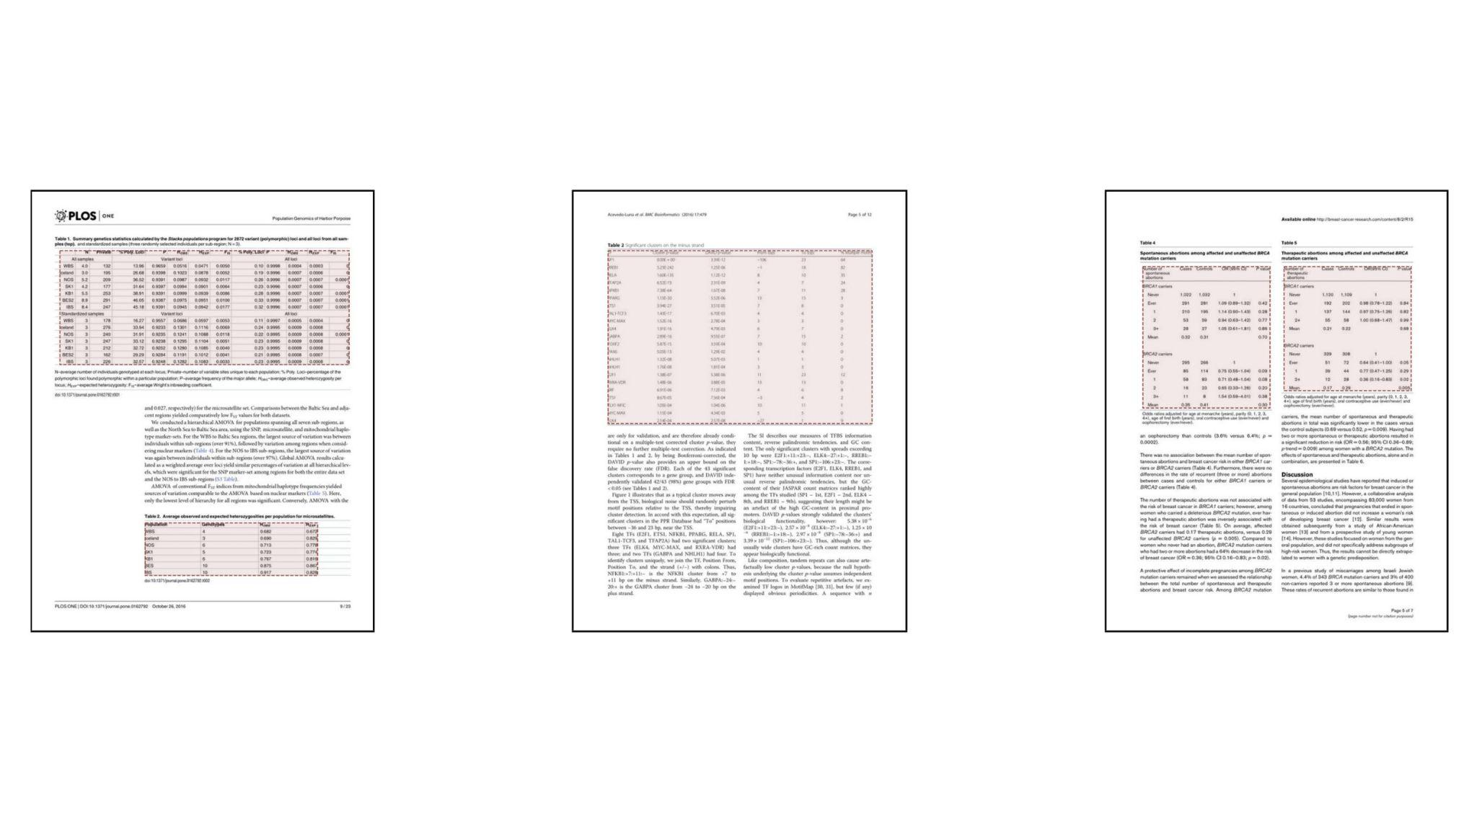
1.2. TD in PubTables-1M
Full dataset in Dataset
cTDaR_t10070.jpg
cTDaR_t10809.jpg
cTDaR_t10085.jpg

Slide 8
1.2.1. Conclusions
Test performance of TD models on PubTables-1M using object detection metrics (Paper).
Model | AP | AP50 | AP75 | AR
Faster R-CNN | 0.825 | 0.985 | 0.927 | 0.866
DETR | 0.970 | 0.995 | 0.989 | 0.985
* Performance on different subsets (AP, AP50, AP75 and AR) of PubTables-1M dataset

Slide 9
2. Table Structure Recognition (TSR)
2.1. TSR in ICDAR 19 TRACK B
Model | 0.6 (IOU F1) | 0.7 (IOU F1) | 0.8 (IOU F1) | 0.9 (IOU F1) | Weighted Average
CascadeTabNet | 0.438 | 0.354 | 0.19 | 0.036 | 0.232
NLPR-PAL | 0.365 | 0.305 | 0.195 | 0.035 | 0.206
Multi-Type-TD-TSR | 0.589 | 0.404 | 0.137 | 0.015 | 0.253
SparkOCR | 0.306 | 0.289 | 0.253 | 0.097 | 0.225
* DETR not included because is trained in PubTables-1M. TSR accuracy in Track B low

Slide 10
2.2. TSR in PubTables-1M
Test performance of TSR models on PubTables-1M (Paper).
Model | AP | AP50 | AP75 | AR
Faster R-CNN | 0.722 | 0.815 | 0.785 | 0.762
DETR | 0.912 | 0.971 | 0.948 | 0.942
* Performance on different subsets (AP, AP50, AP75 and AR) of PubTables-1M dataset
Fine-tunning DETR
Follow steps in https://github.com/microsoft/table-transformer

Slide 11
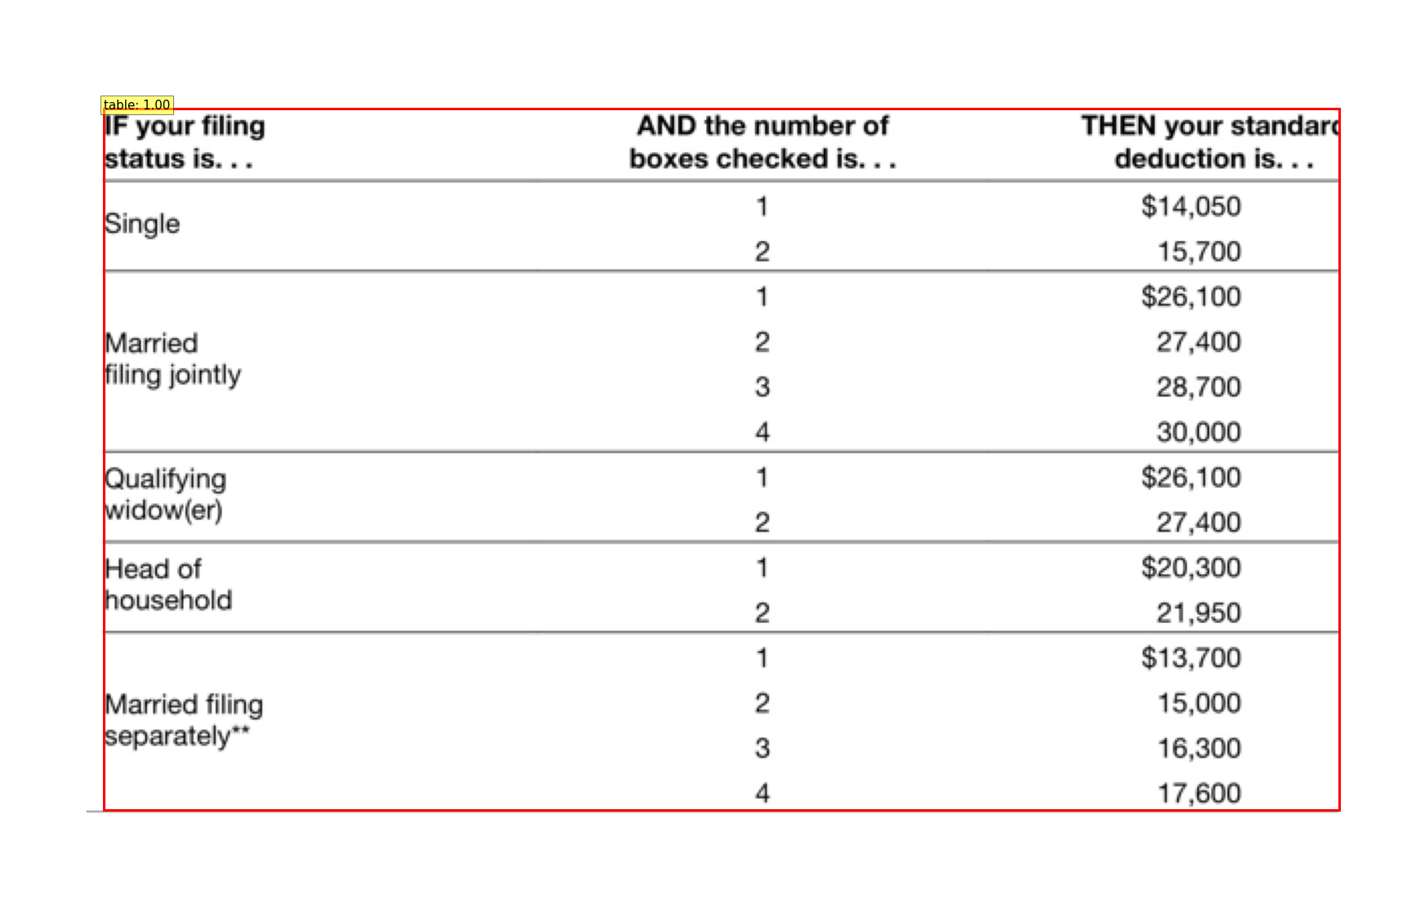
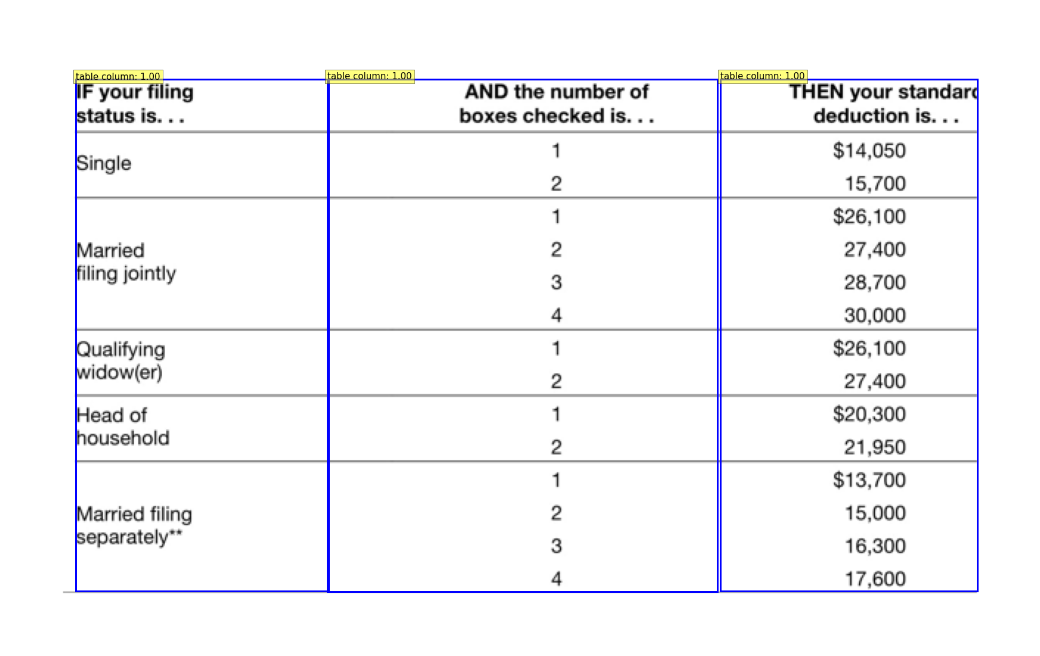
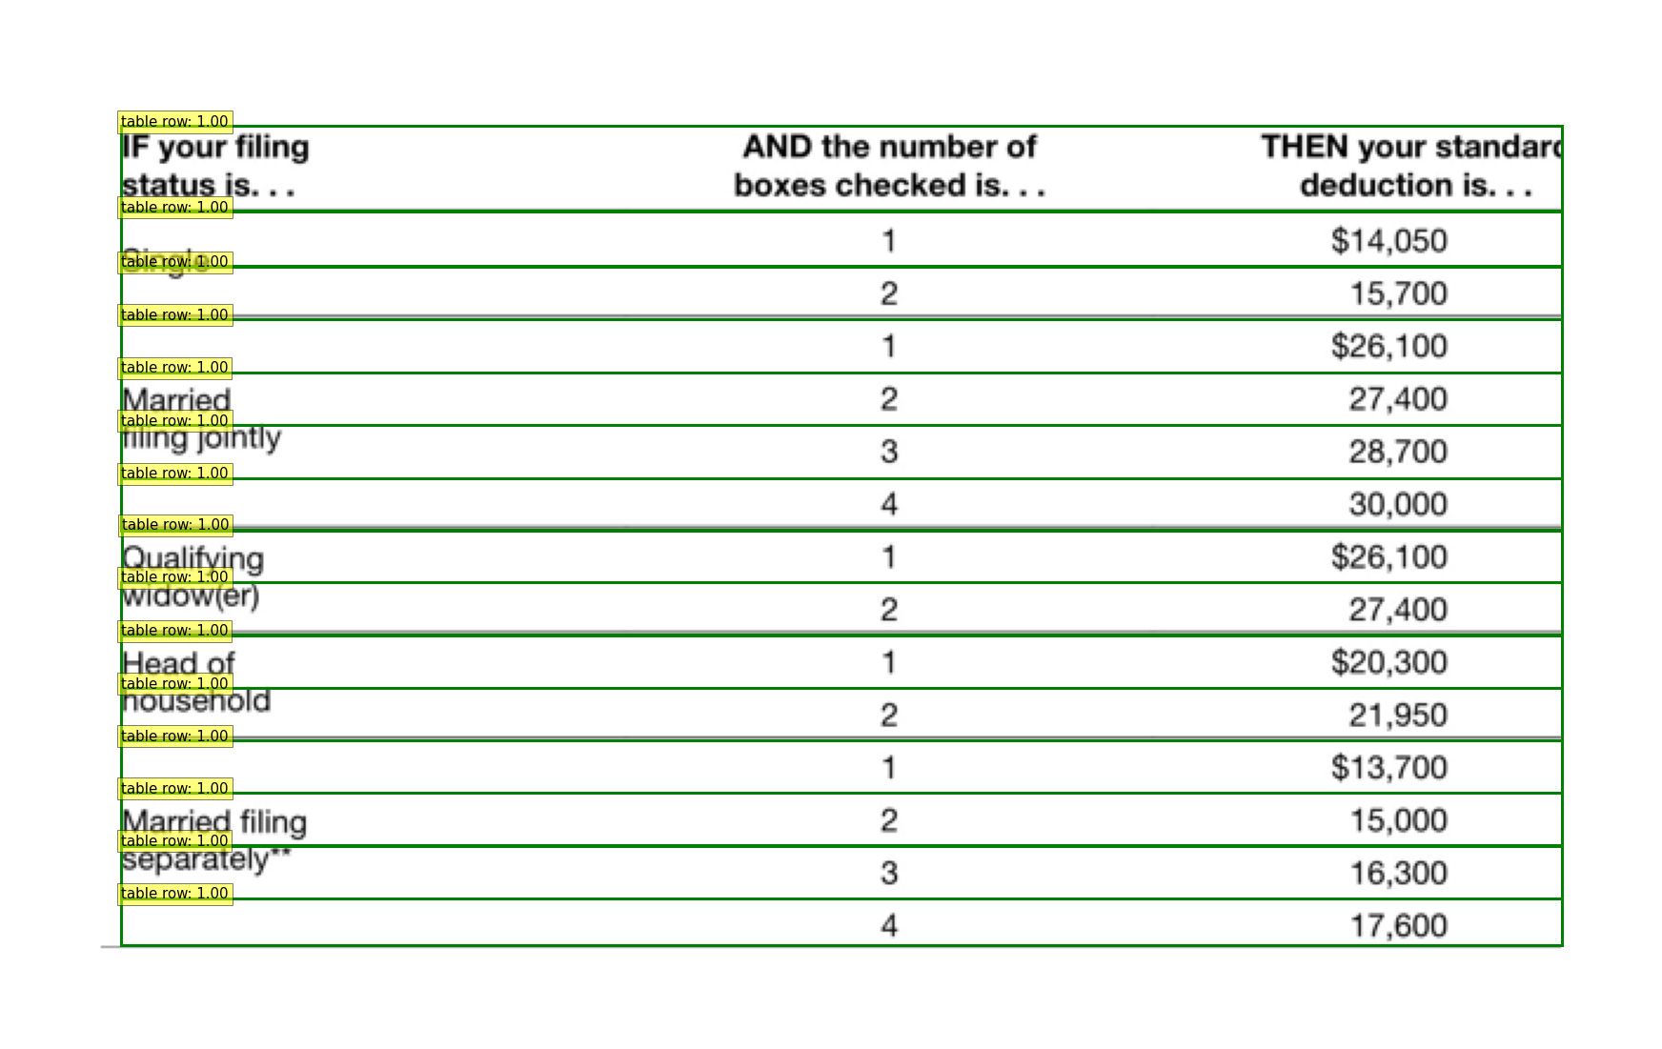
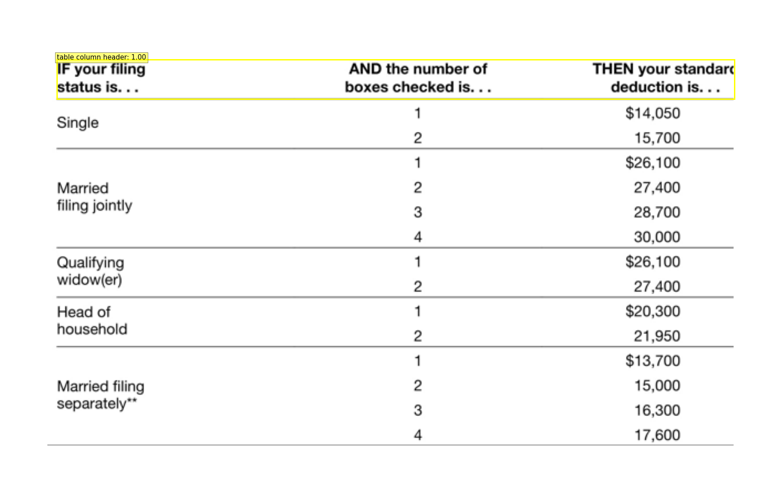
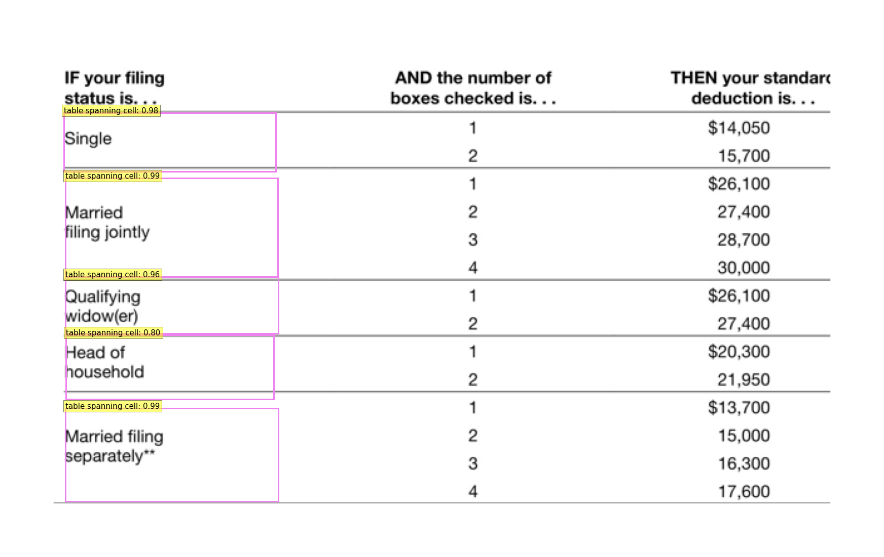
2.3. DETR TSR visual example
table
columns
TSR Classes
0: 'table',
1: 'table column',
2: 'table row',
3: 'table column header',
4: 'table projected row header',
5: 'table spanning cell'
rows
table column header
table spanning cell

